Slide 1


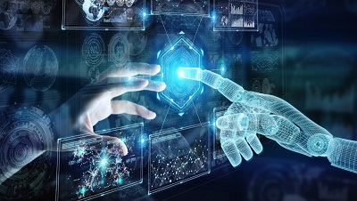
Optimizing Unmanned Hotels Using Gesture Recognition
Fung King Shun

Slide 2
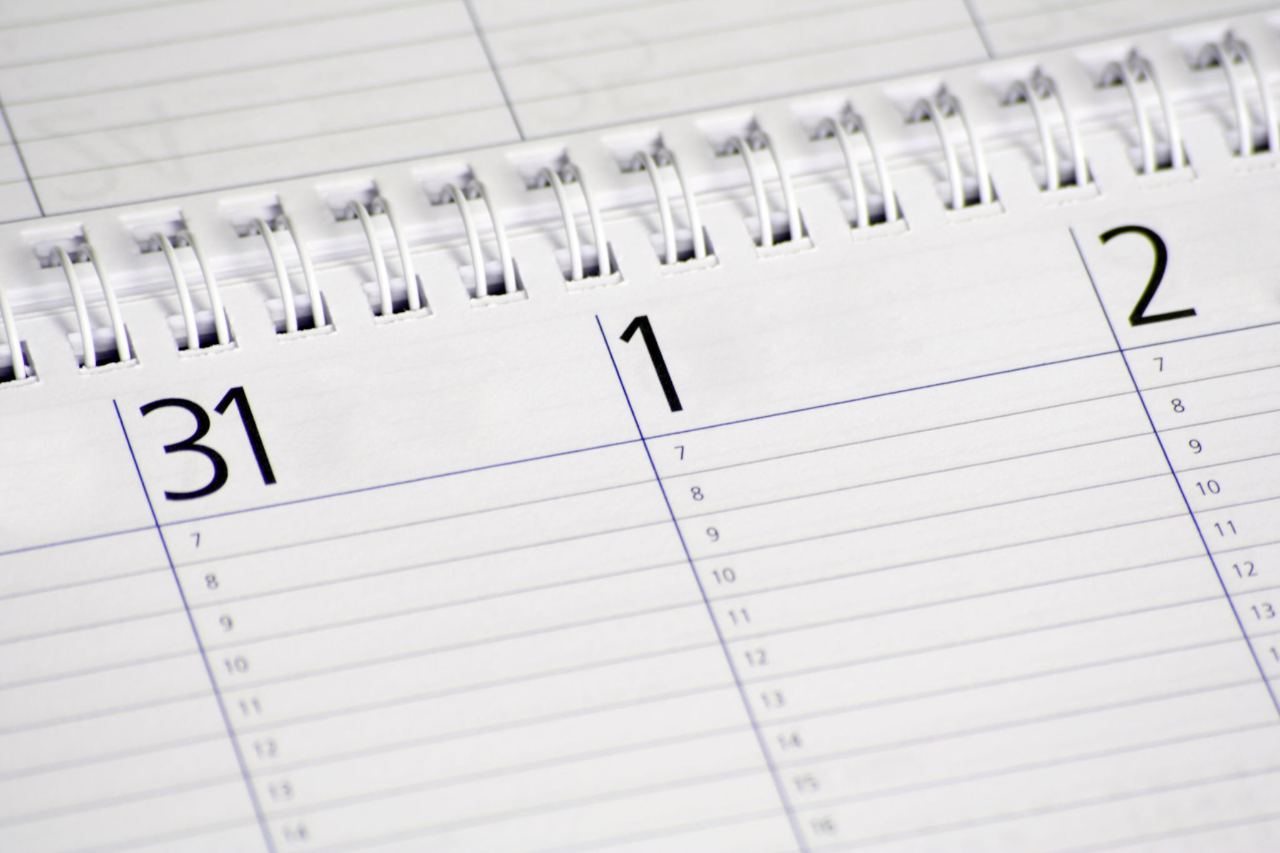
Agenda
Introduction & Background
System Design
Product Results
Future Work
Conclusion

Slide 3
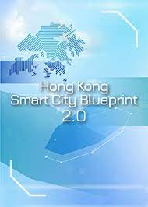
Background – Motivation and Problem
To solve traditional hotel business operations:
Avoid public health crises
The Hong Kong government‘s “Hong Kong Smart City Blueprint”:
Impalement Smart City 2.0

Slide 4
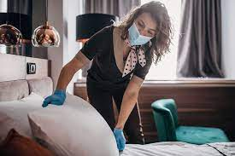
Background – public health crises
Definition: Any event that endangers the health of the people
Observant past epidemics in traditional hotels
Traveler get infected in hotels
Affect the city's economy

Slide 5
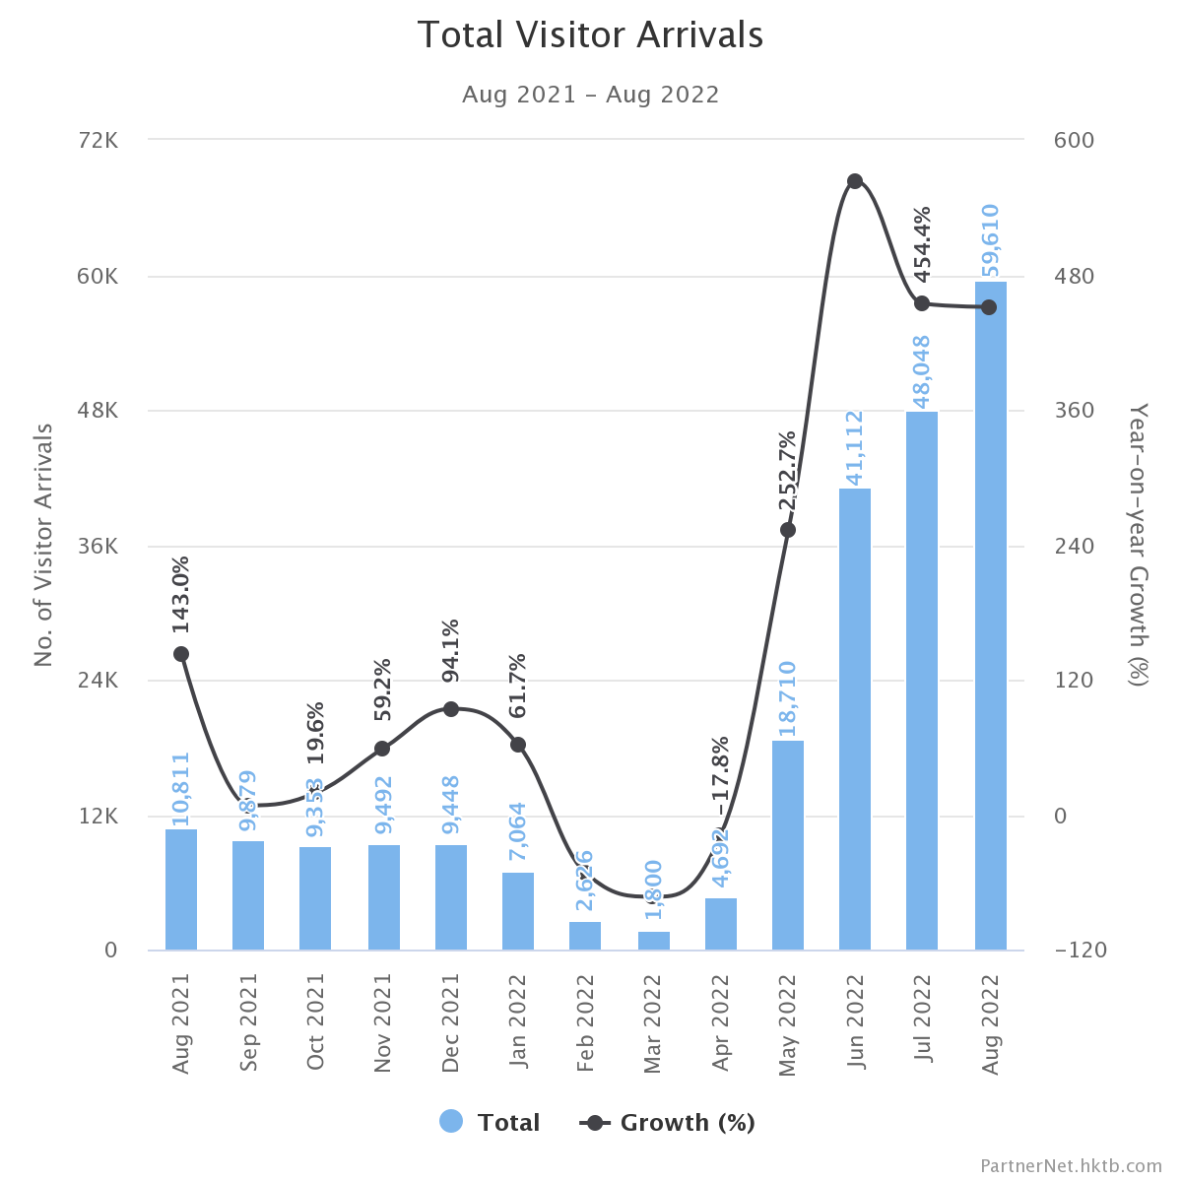
HK：In the past 2021-2022, about 230,000 people visited Hong Kong

Slide 6
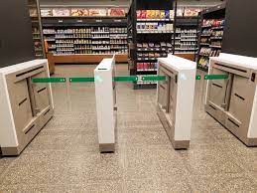
Background – Hong Kong Smart City Blueprint
Goal: To build a smart city 2.0 with economy and a high-quality life
Unmanned facilities are one of development
Unmanned convenience store started operating at Hong Kong International Airport in 2023
Unmanned hotels also have potential

Slide 7
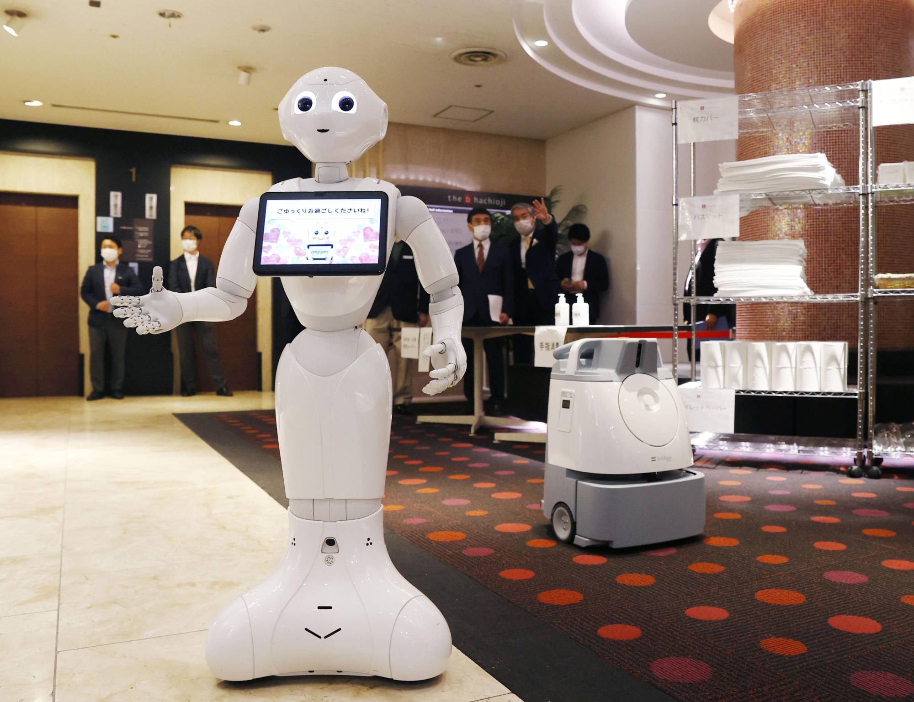
Background – Need & Solution
Non-contact technology
improve traditional hotel business operations
improve hotel convenience and security
improve user experience
Solution: Optimizing by Using Gesture Recognition

Slide 8
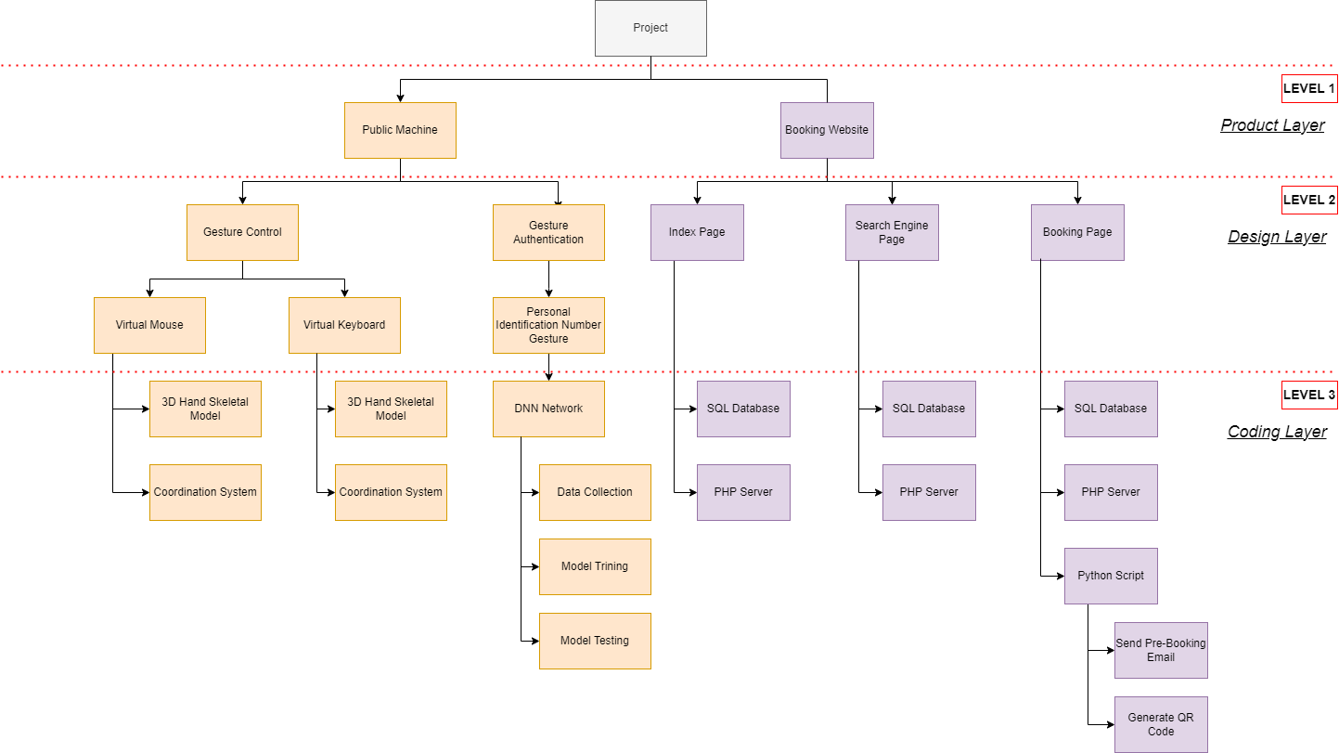
System Design - Architectures

Slide 9
System Design - Product Level
Public Machine (check-in machine handle check-in process)
Booking Website (online website handle the pre-order booking)

Slide 10
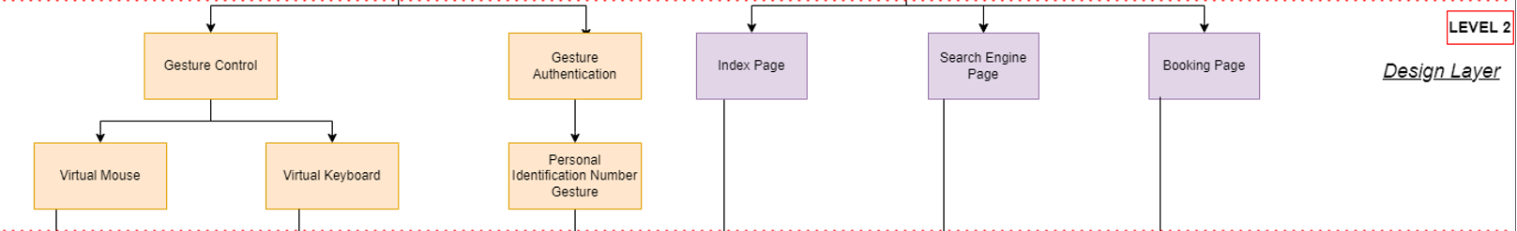
System Design - Design Level
Gesture Control (control the public machine)
Gesture Authentication (custom own gesture to unlock room door)

Slide 11
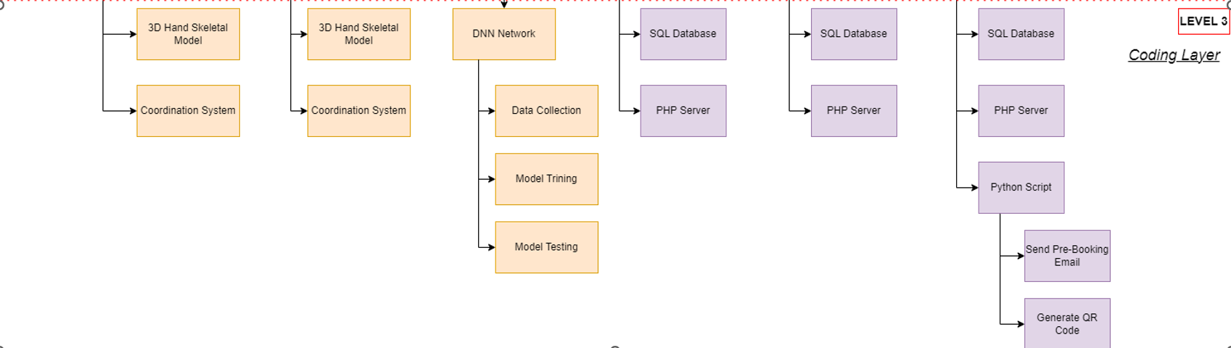
System Design - Coding Level

Slide 12
System Design - Methodology
Public Machine (Python + PHP website UI)
3D hand skeleton model
Virtual Mouse & Keyboard
AI model for gesture authentication to unlock room door
Booking Website (PHP website UI)
Web server
Database

Slide 13
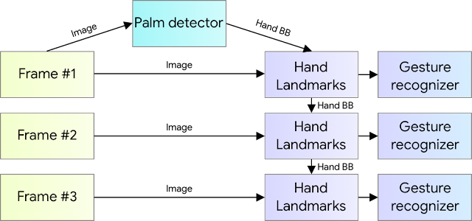
Design - 3D Hand Skeleton (1)
How to detect hand and build skeleton ?
Python library: Opencv + CVZone

Slide 14

Design - 3D Hand Skeleton (2)

Slide 15
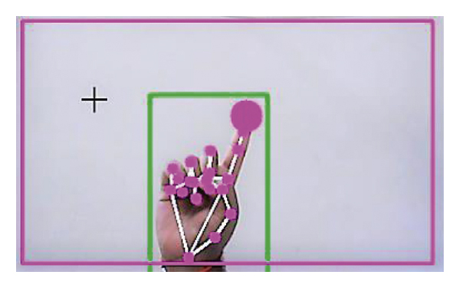
System Design - Virtual Mouse & Keyboard (1)
Mouse Function
Mouse Moving
Mouse right click
Change to keyboard mode
Keyboard Function
Keyboard text input
Change to mouse mode

Slide 16
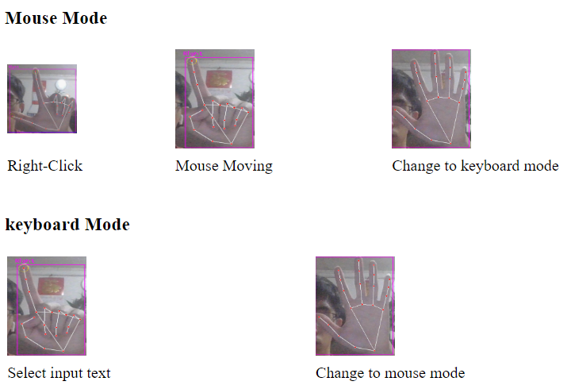
System Design - Virtual Mouse & Keyboard (4)

Slide 17
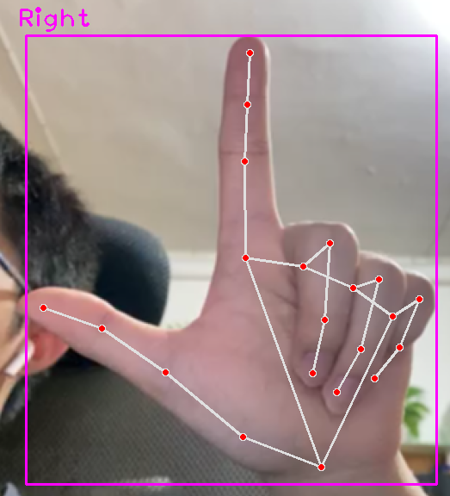
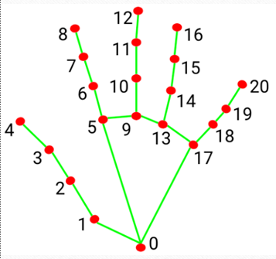
System Design - Virtual Mouse & Keyboard (2)
Coordination Calculation
1. Analyze the coordinate changes
first pair of key points like (4,3), (8,7), (12,11) …
2. If Y-axis key points (4>3), then finger up as 1
3. Else (3>4), then finger down as 0
4. Finally, can get 5 digits code
5 digits code: (1,1,0,0,0)

Slide 18
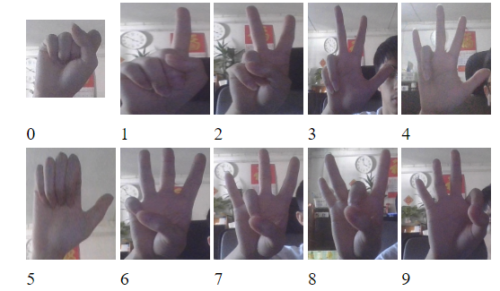
System Design - Gesture Authentication(1)
Personal Identification Number Gesture (PING)

Slide 19
System Design - Gesture Authentication(2)
Not Using Coordination Calculation Method
Sometime the identification accuracy is low
New Method: Training deep neural network (DNN)

Slide 20
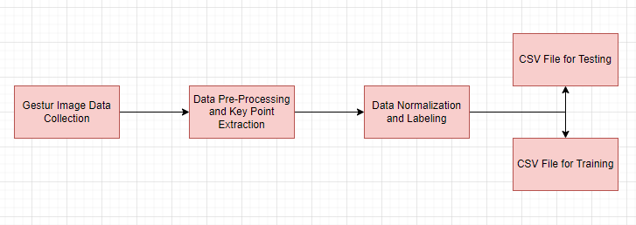
System Design - Gesture Authentication(3)
Data Collection

Slide 21
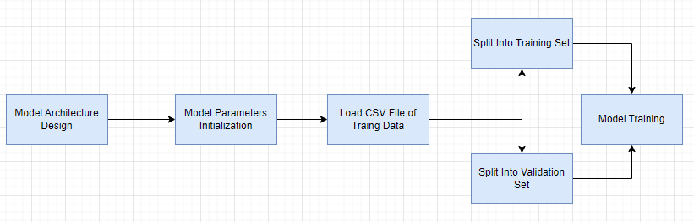
System Design - Gesture Authentication(4)
Training

Slide 22
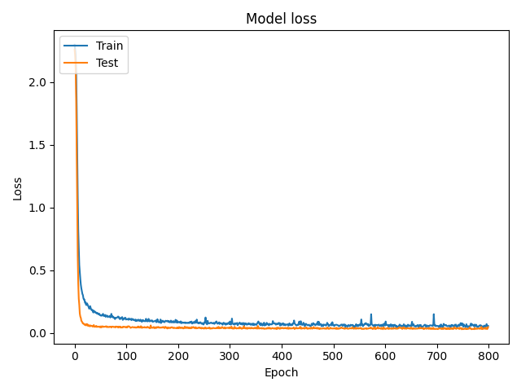
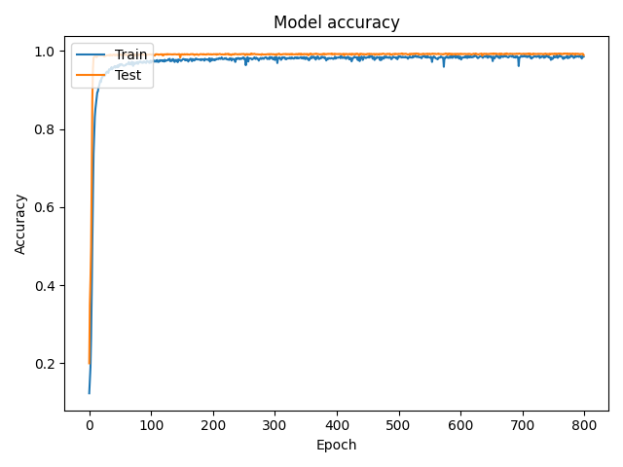
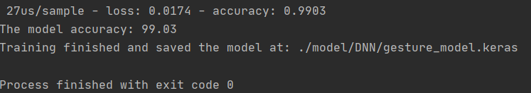
System Design - Gesture Authentication(4)

Slide 23
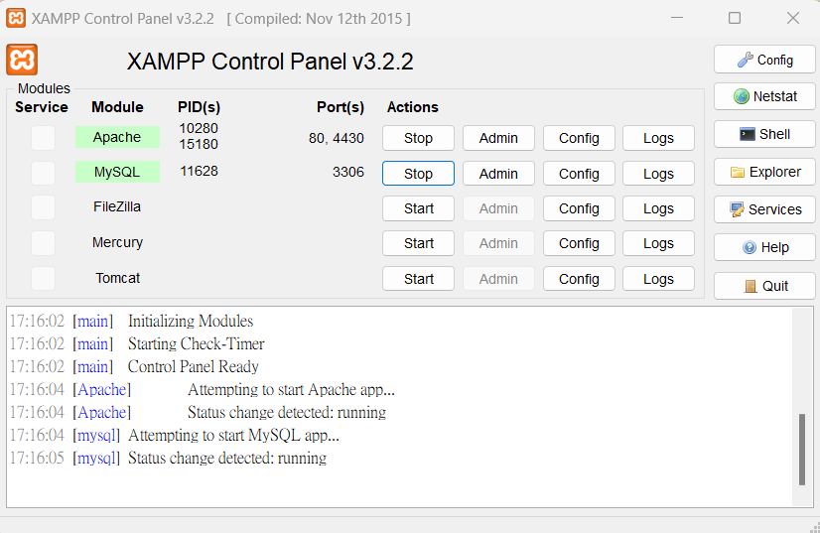
System Design - Booking Website

Slide 24
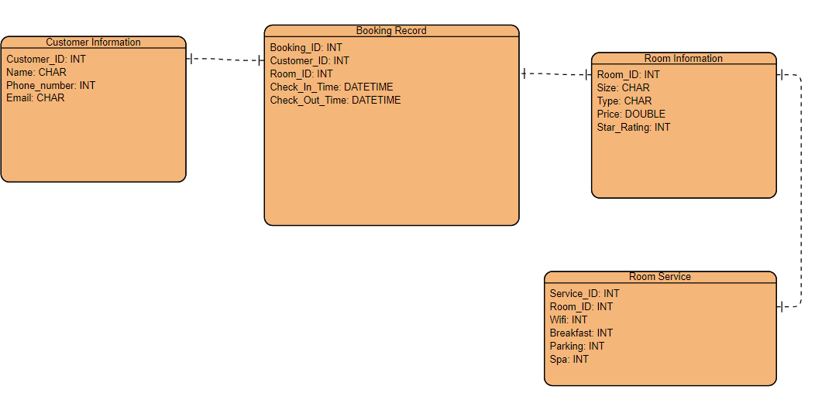
System Design - Database

Slide 25
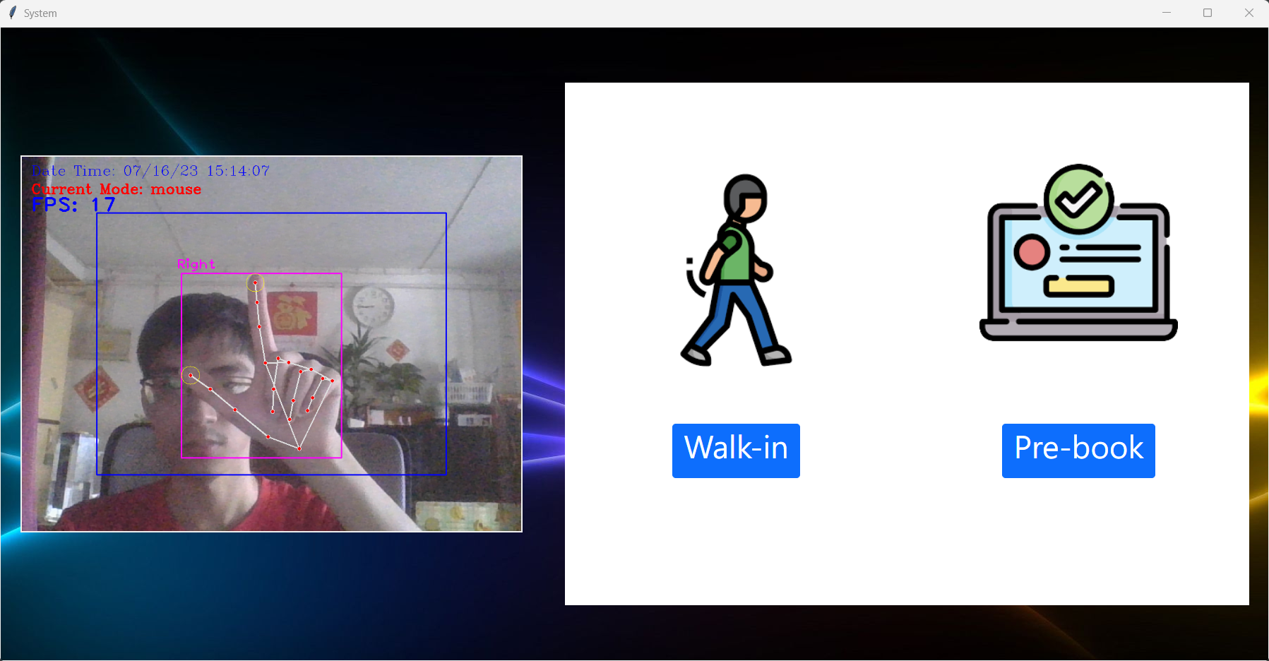
Product Result - Virtual Mouse & Keyboard

Slide 26
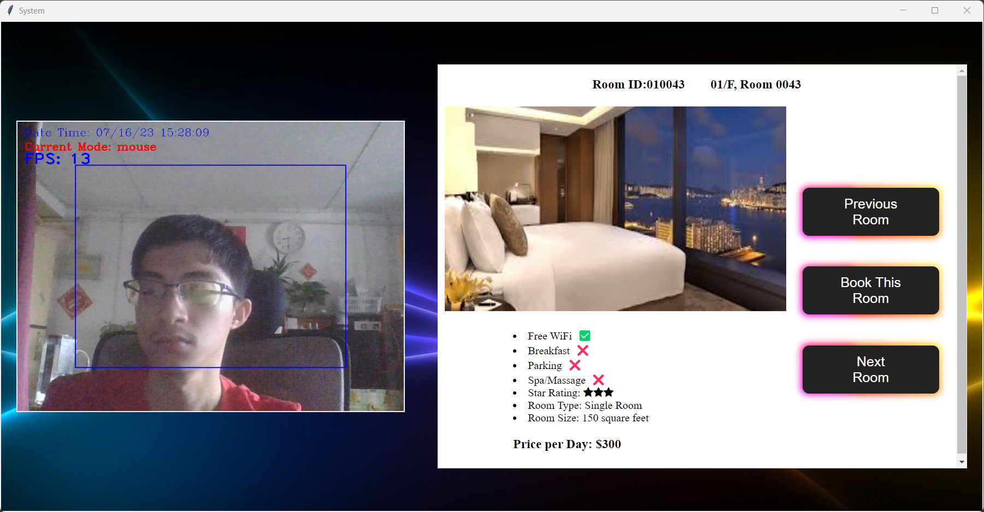
Product Result - Virtual Mouse & Keyboard

Slide 27
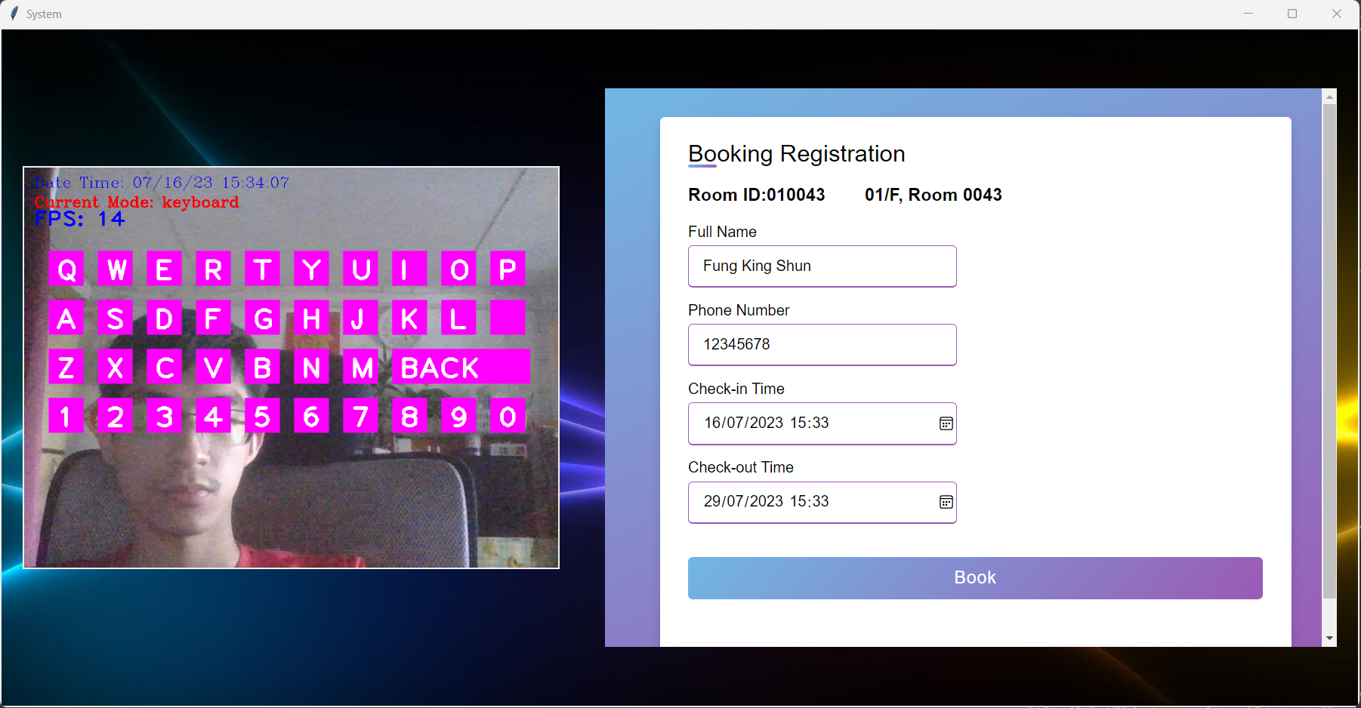
Product Result - Virtual Mouse & Keyboard

Slide 28
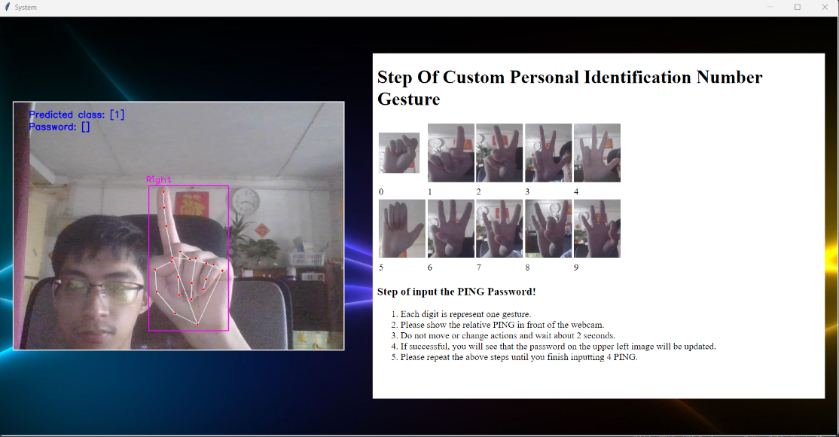
Product Result - Gesture Authentication

Slide 29
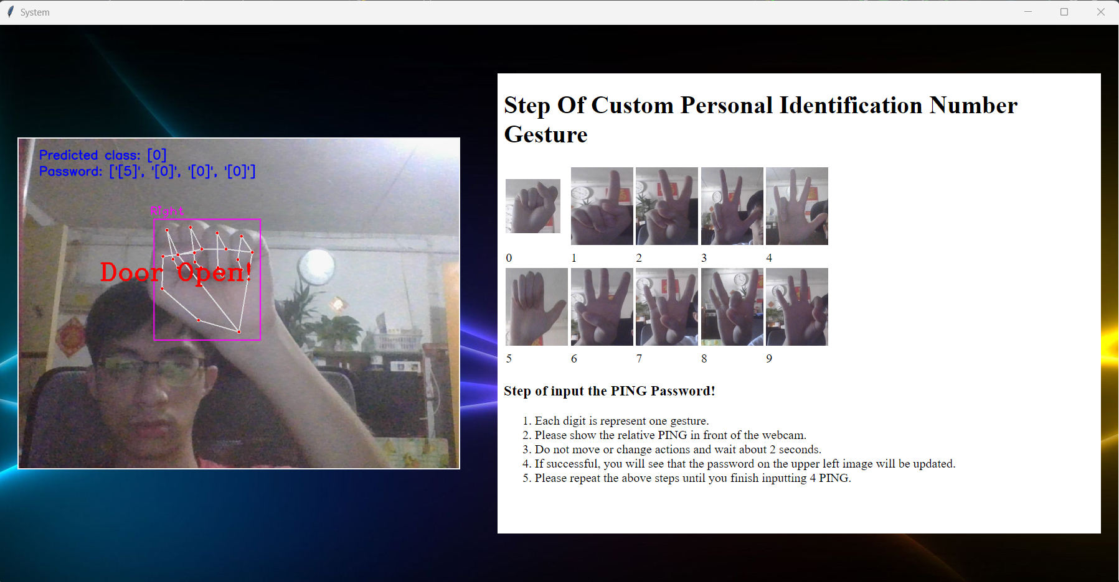
Product Result - Gesture Authentication

Slide 30
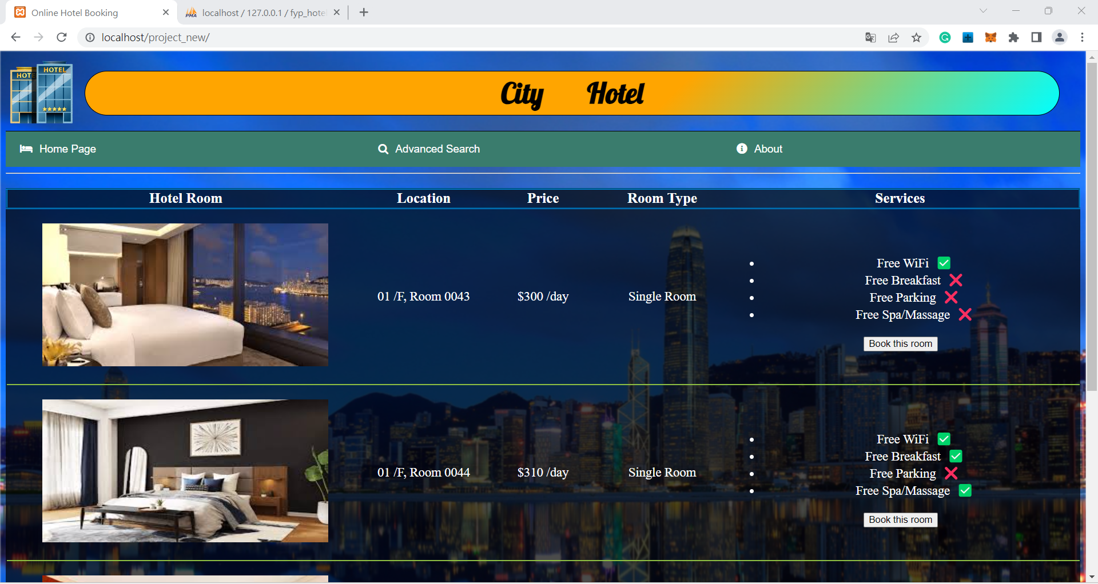
Product Result – Booking Website

Slide 31
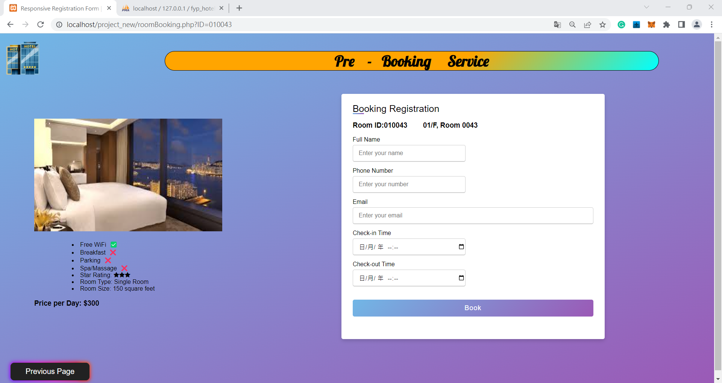
Product Result – Booking Website

Slide 32
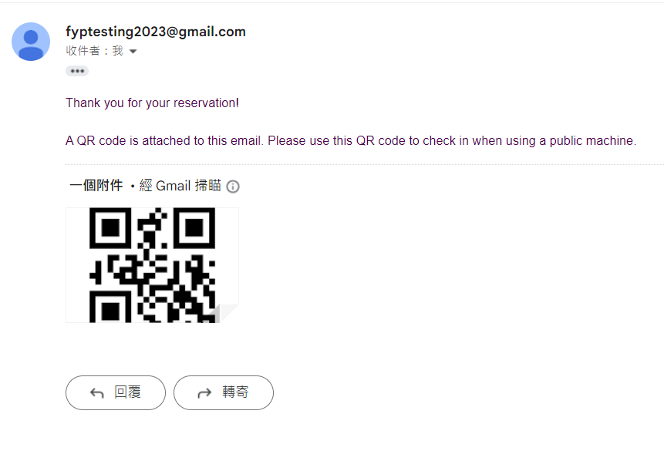
Product Result – Booking Email

Slide 33
Future Work
Public Machine
training one more DNN model for authentication detect left hand action and
left-hand detection of virtual control
Online Booking Website
provide more functionality

Slide 34
Conclusion
Successfully created a virtual mouse and virtual keyboard to operate public machines
Developed an online booking website make booking process easier
A reliable AI model for unlocking room doors
Optimized traditional hotel operations
Offers innovative solutions to improve guest convenience in the hotel industry

Slide 35
References
Valentin Bazarevsky and Fan Zhang, Research Engineers, Google Research. On-Device, Real-Time Hand Tracking with MediaPipe. Retrieved MONDAY, AUGUST 19, 2019, from https://ai.googleblog.com/2019/08/on-device-real-time-hand-tracking-with.html

Slide 36

Q & A

Slide 37
Thank You

